Slide 1
Scene interaction
Advanced Graphics Programming

Slide 2
Overview
Camera navigation
Free navigation
Object inspection
Object selection
Object transformations

Slide 3
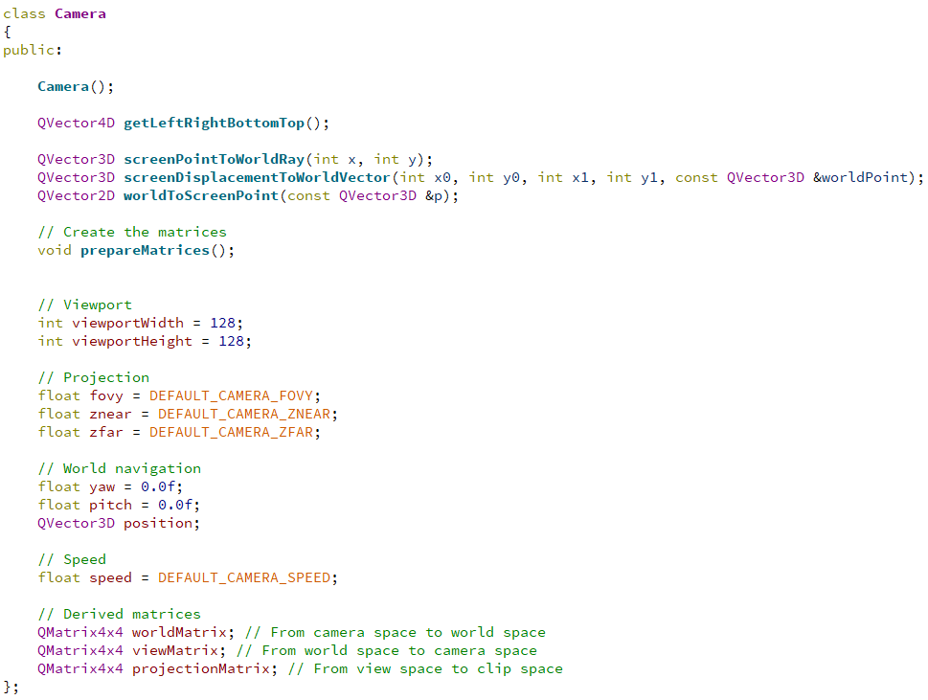
Camera class
Scene interaction is closely related to the concept of camera
Extracts znear corners
Utility methods
Updates worldMatrix, viewMatrix,
and projectionMatrix
Camera parameters
Derived matrices

Slide 4
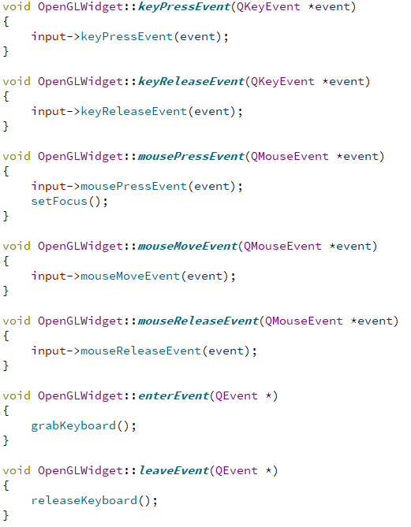
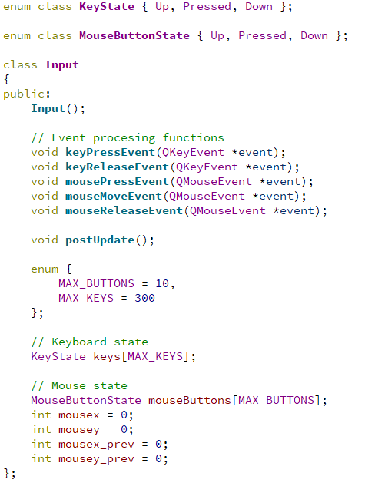
Capturing Qt events from the OpenGL widget
OpenGLWidget class
Input class
Forward events
Enable this in OpenGLWidget constructor:

Slide 5
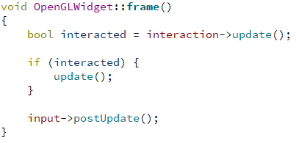
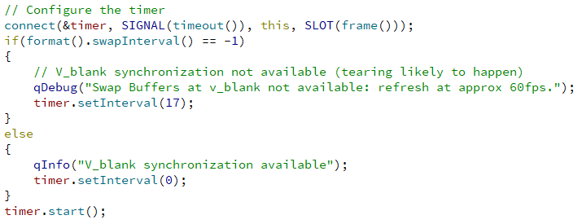
Enable interaction updates in your OpenGL widget
OpenGLWidget class
Call frame… at each frame
Update rendering only after interactions
How?
Install a timer that calls the function
For example, in the OpenGL widget’s constructor:
timer is a data member of OpenGLWidget
frame must be a slot of OpenGLWidget

Slide 6
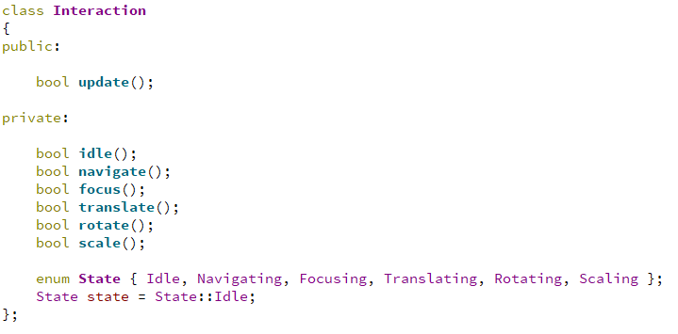
Interaction class
Called at each frame

Slide 7
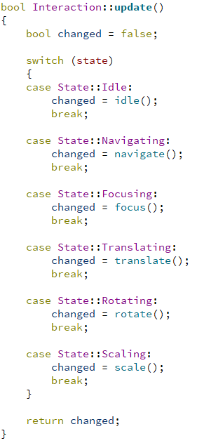
Interaction class
Can operate in different states
Returns a boolean
False: Nothing changed
True: Used interacted
The caller (e.g. OpenGL widget) will update rendering

Slide 8
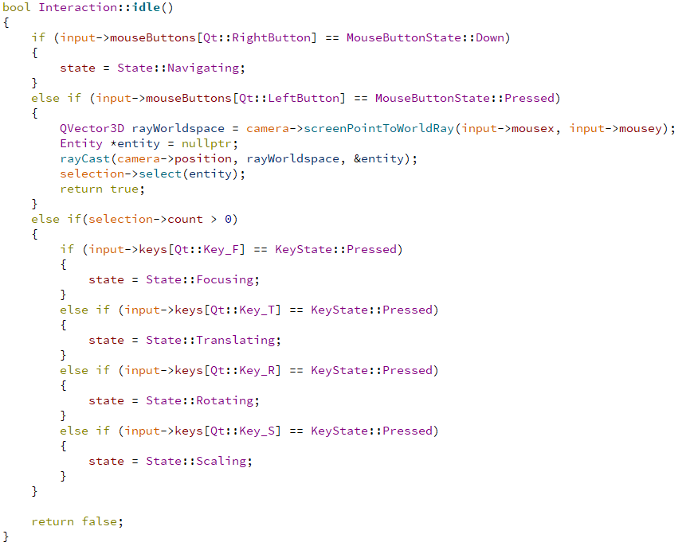
Interaction class
Single left-click selection will return true so that the selection hint (outline, bounding box…) is rendered.

Slide 9
Interaction class
Unity-like: mouse right click enters free navigation mode (WASD).

Slide 10
Camera navigation

Slide 11
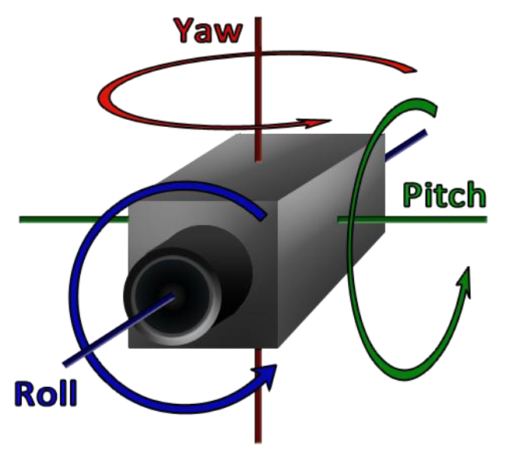
Camera navigation
Navigation parameters

Slide 12
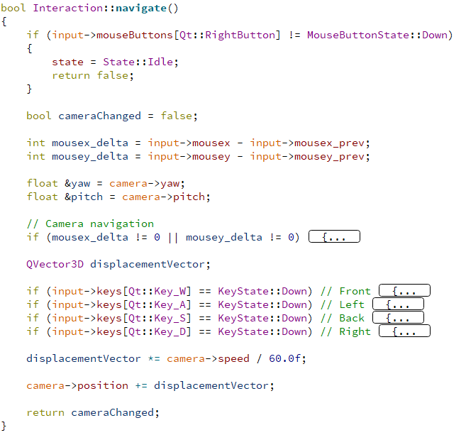
Camera navigation

Slide 13
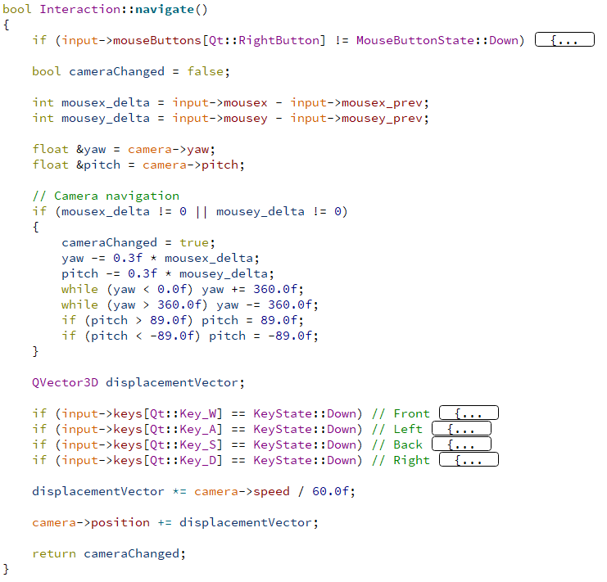
Camera navigation

Slide 14
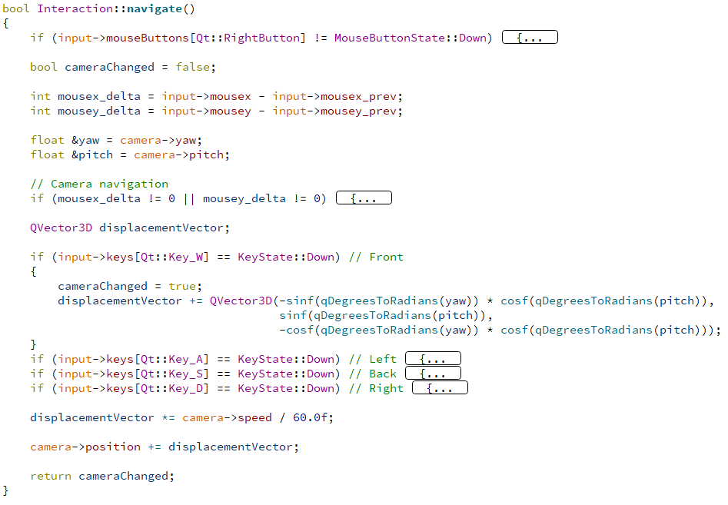
Camera navigation
fake delta time :-P

Slide 15
Camera navigation
Navigation parameters
Derived matrices

Slide 16
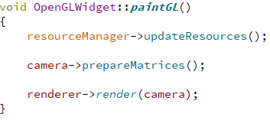
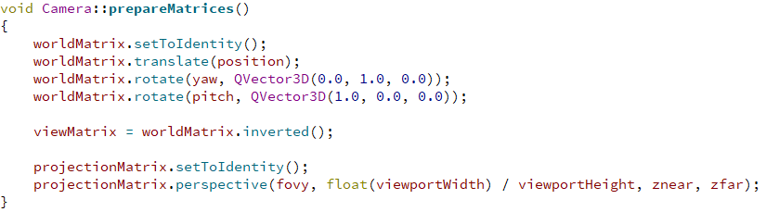
Camera navigation
Each time before rendering
Update camera matrices
Not to confuse with the world matrix (also called model matrix) of any other entity in your scene:
This camera’s worldMatrix transforms from view space (camera’s local space) to world space
Inverse of viewMatrix.

Slide 17
Selection

Slide 18
Object selection

Slide 19
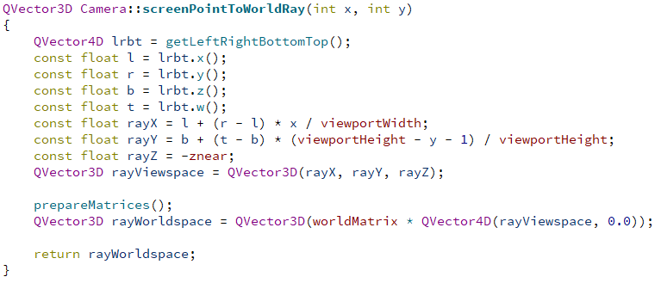
Object selection: Ray creation
Left, right, bottom, and top, define the corners of near plane in view space.
rayX and rayY obtained by interpolation between the corners of the near plane.

Slide 20
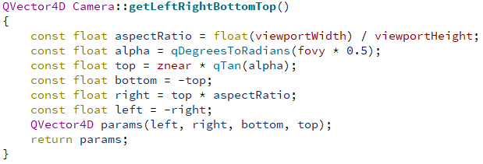
Object selection: Ray creation

Slide 21
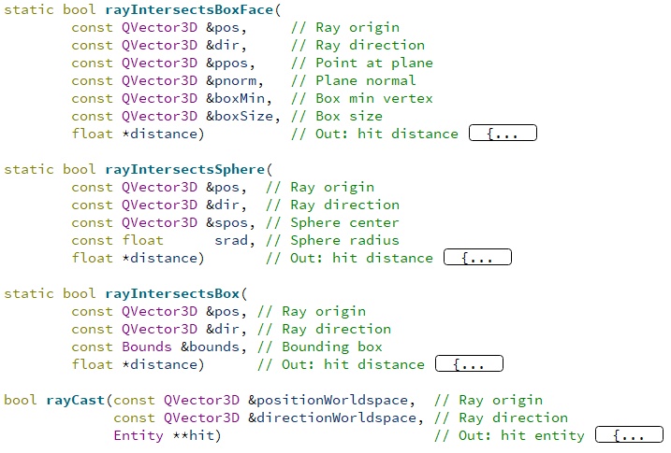
Object selection: Intersection tests

Slide 22
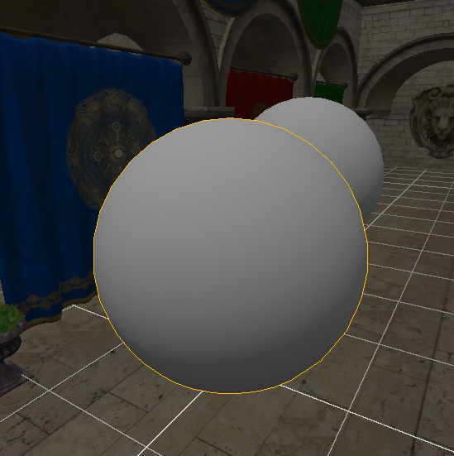
Object selection: More precise intersection tests
Using ray-box intersections
Selection errors
The bounding box is bigger than the sphere
Even worse with other kinds of models
Solution
After finding ray-box intersection, refine intersection test
Traverse all model triangles
Ray-triangle intersection test

Slide 23
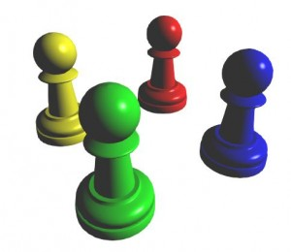
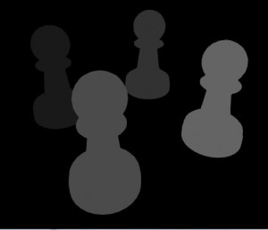
Object selection: More precise intersection tests
Yet another solution
Pre-requisites:
Objects have identifiers
Create a special selection texture
Size of the viewport
1-component (not RGBA)
Pixel type: unsigned integer
Steps on mouse click:
Use selection texture render target
Render scene object identifiers
Download texture from GPU
glReadPixels() function
Read identifier at the clicked pixel coords
Select object with the given identifier
Texture of identifiers

Slide 24
Object transformations

Slide 26
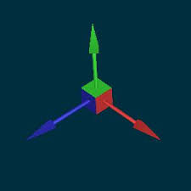
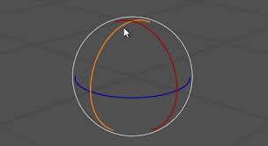
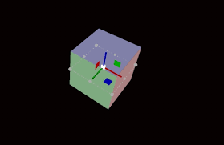
Object transformations
Guizmos

Slide 27

Questions?

